Slide 1
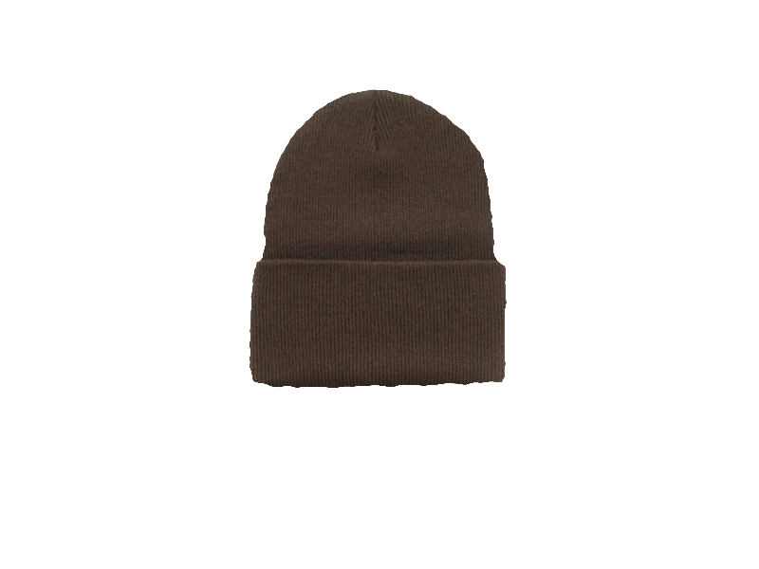
Space Game
Johnathan Snyder, Craig Robinson,
Brian Tillery, The Hat

Slide 2
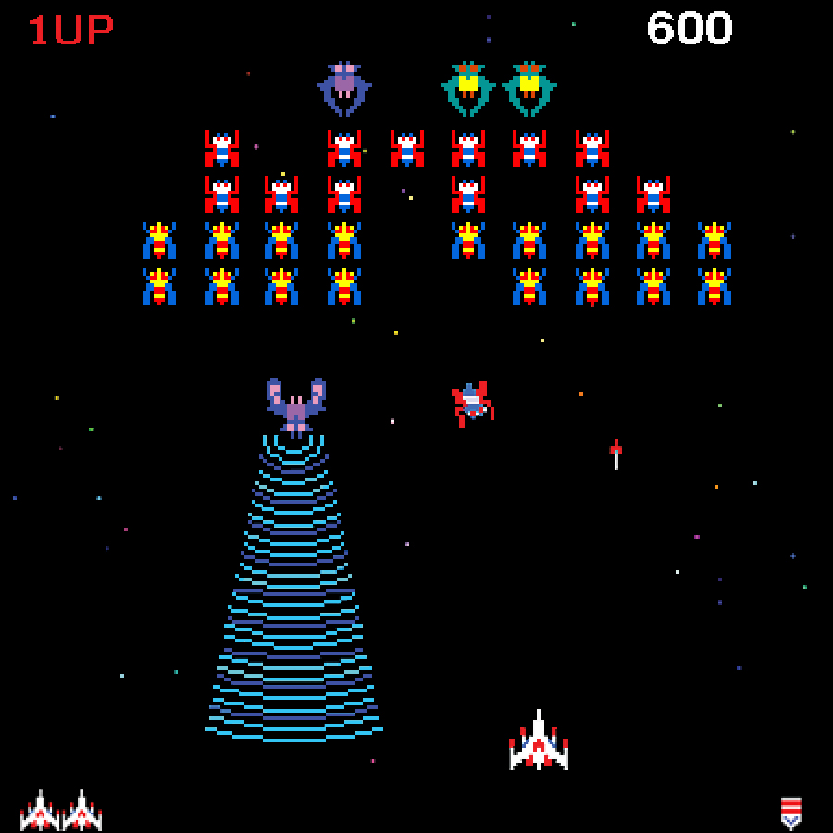
Problem Definition - The Goal (Refresher)
The goal of Space Game is simple: to provide a fun, free, and engaging experience to a general audience.
The great spaceship games of yesterday still provide inspiration.

Slide 3
Scope (Refresher)
Currently, Space Game is only designed for Google’s Android platform and is purely intended as a form of entertainment for any participating user.
All progress, high scores, and other data will be stored locally in a database.

Slide 4
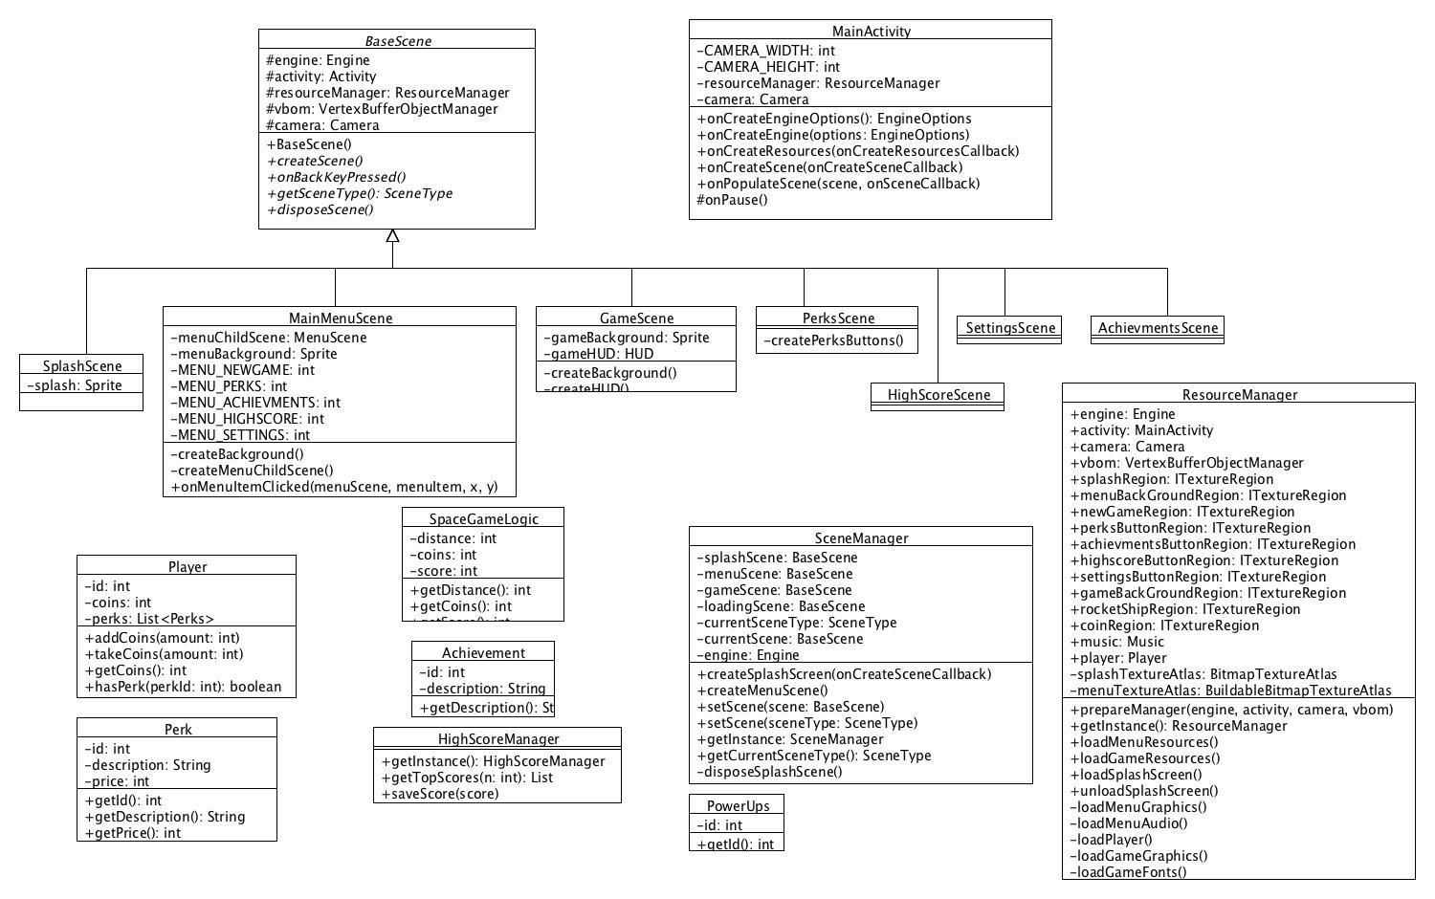
Detailed Class Diagram

Slide 5
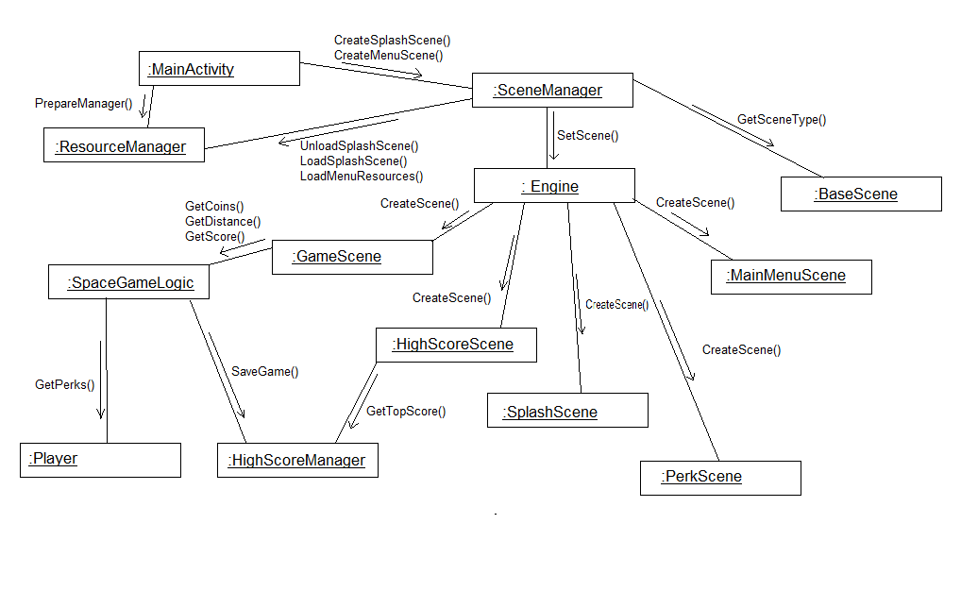
Collaboration Diagram

Slide 6
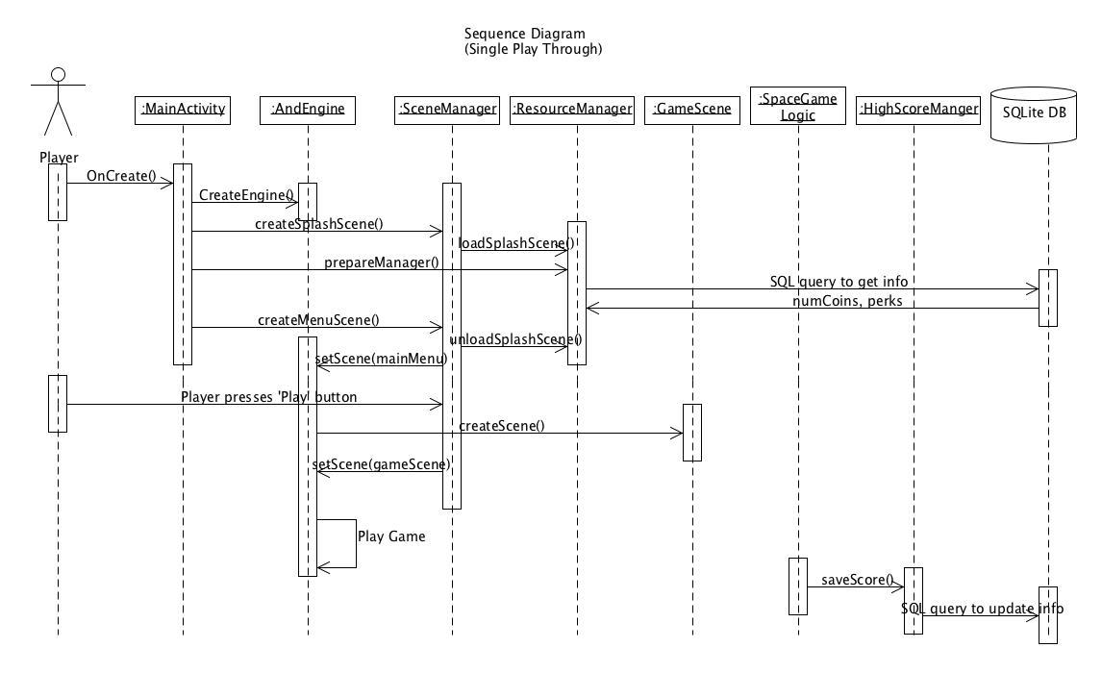
Sequence Diagram

Slide 7
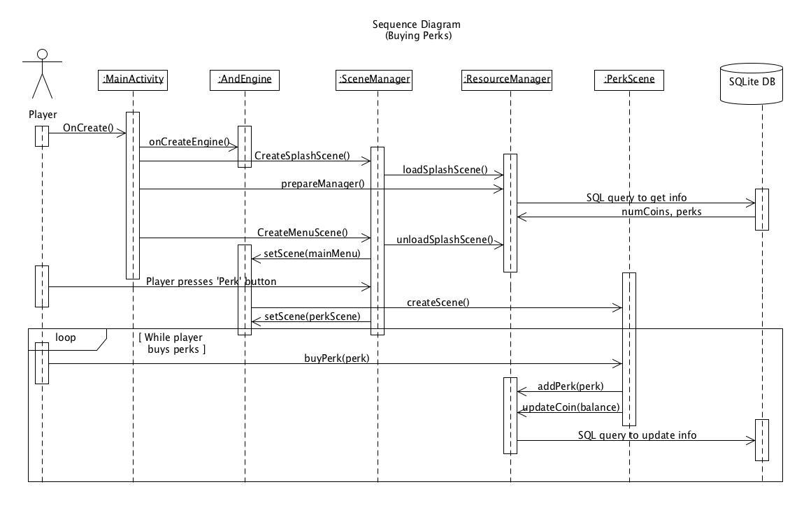
Sequence Diagram 2

Slide 8
Updates
No specific changes to project mechanics or goals
Inclusion of the hat is of a higher priority now

Slide 9
Summary Discussion
Group responsibilities have not changed
With the diagrams, Space Game is looking more and more feasible and there is much less concern about inability to implement features.

Slide 10
Questions?

